Slide 1
CS2040S Tutorial 7

Slide 2
Tutorial Time
Slides for tutorials are taken and adapted from Christian

Slide 3

Hash Table: Motivation
Suppose you are the police and just caught some criminal

Slide 4
Hash Table: Motivation
Suppose you are the police and just caught some criminal
You want to lookup in the database of fingerprints to verify the identity of this criminal

Slide 5
Hash Table: Motivation
Suppose you are the police and just caught some criminal
You want to lookup in the database of fingerprints to verify the identity of this criminal
We need an ADT which supports very fast lookups

Slide 6

AVL Trees are fast..
But can we go faster???

Slide 7
Enter the Symbol Table ADT!
It should support the following operations:

Slide 8
Enter the Symbol Table ADT!
It should support the following operations:
insert(key, value)
search(key)
delete(key)
contains(key)
size()
All in expected O(1) time!

Slide 9
Trade-offs
We know binary search takes Ω(logn) comparison. So how is searching in a symbol table so fast??

Slide 10
Trade-offs
We know binary search takes Ω(logn) comparison. So how is searching in a symbol table so fast??
Binary search is comparison-based! Symbol table is not.

Slide 11
Trade-offs
We know binary search takes Ω(logn) comparison. So how is searching in a symbol table so fast??
Binary search is comparison-based! Symbol table is not.
Consequence: Any ordering-based operations such as become slow.
max
or
successor

Slide 12

No free lunch!
Data Structure | Avg Insert | Avg Search | Avg Max/Min | Avg succ/pred
AVL Tree | O(logn) | O(logn) | O(logn) | O(logn)
Hash Table | O(1) | O(1) | O(n) | O(n)
Where n is the number of items in the data structure.

Slide 13
Building a Hash Table

Slide 14
First try: Direct Access Table

Slide 15
First try: Direct Access Table
Idea: Just use an array! A super hugeeeeeeeeeeee one

Slide 16
First try: Direct Access Table
Idea: Just use an array! A super hugeeeeeeeeeeee one
0
1
2
3
null
null
null
null
...
...
null
null
null
null
n-4
n-3
n-2
n-1

Slide 17
First try: Direct Access Table
Very easy to see that inserting and searching will now take O(1) time. Because we are using an array!

Slide 18
First try: Direct Access Table
Very easy to see that inserting and searching will now take O(1) time. Because we are using an array!
Also very easy to see that this takes tooooooo much space!

Slide 19
Second try: Hashing with Chaining
Direct Access Tables are too expensive! Use a smaller table.

Slide 20
Second try: Hashing with Chaining
Direct Access Tables are too expensive! Use a smaller table.
Define a hash function to “map” the key to a particular index of the table

Slide 21
Second try: Hashing with Chaining
Direct Access Tables are too expensive! Use a smaller table.
Define a hash function to “map” the key to a particular index of the table
There are potentially collisions, but that’s okay because we can just create a linked list of them!

Slide 22
Each bucket “chains” a linked list of items
Let’s define a hash function h(x) = x % 10

Slide 23
Each bucket “chains” a linked list of items
Let’s define a hash function h(x) = x % 10
null
null
null
null
null
null
null
null
0
1
2 |  |  | 12 |  |  | 72 |  |  | 52
3
4
5
6
7
8
9 |  |  | 99 |  |  | 49

Slide 24
Each bucket “chains” a linked list of items
Let’s define a hash function h(x) = x % 10
If we have m buckets and n items, what’s the space complexity?
0
1
2
3
4
5
6
7
8
9
null
null
null
null
null
null
null
null
12
72
52
99
49

Slide 25
Each bucket “chains” a linked list of items
Let’s define a hash function h(x) = x % 10
If we have m buckets and n items, what’s the space complexity?
Θ(m + n)
null
null
null
null
null
null
null
null
0
1
2 |  |  | 12 |  |  | 72 |  |  | 52
3
4
5
6
7
8
9 |  |  | 99 |  |  | 49

Slide 26
Each bucket “chains” a linked list of items
Let’s define a hash function h(x) = x % 10
If we have m buckets and n items, what’s the space complexity?
Θ(m + n)
NOT Θ(mn)
null
null
null
null
null
null
null
null
0
1
2 |  |  | 12 |  |  | 72 |  |  | 52
3
4
5
6
7
8
9 |  |  | 99 |  |  | 49

Slide 27
Each bucket “chains” a linked list of items
Let’s define a hash function h(x) = x % 10
If we have m buckets and n items, what’s the space complexity?
Θ(m + n)
NOT Θ(mn)
null
null
null
null
null
null
null
null
0
1
2 |  |  | 12 |  |  | 72 |  |  | 52
3
4
5
6
7
8
9 |  |  | 99 |  |  | 49
m
n

Slide 28

Insertions
Insert(25)
What will happen?
Let’s define a hash function h(x) = x % 10
null
null
null
null
null
null
null
null
0
1
2 |  |  | 12 |  |  | 72 |  |  | 52
3
4
5
6
7
8
9 |  |  | 99 |  |  | 49

Slide 29
Insertions
Insert(25)
Insert into bucket 5!
Let’s define a hash function h(x) = x % 10
null
null
null
null
null
null
null
0
1
2 |  |  | 12 |  |  | 72 |  |  | 52
3
4
5 |  |  | 25
6
7
8
9 |  |  | 99 |  |  | 49

Slide 30
Insertions
Insert(32)
How?
Let’s define a hash function h(x) = x % 10
null
null
null
null
null
null
null
0
1
2 |  |  | 12 |  |  | 72 |  |  | 52
3
4
5 |  |  | 25
6
7
8
9 |  |  | 99 |  |  | 49

Slide 31
Insert(32)
Insertions
Let’s define a hash function h(x) = x % 10
Can just put at the head of the list!
null
null
null
null
null
null
null
0
1
2 |  |  | 32 |  |  | 12 |  |  | 72 |  | 52
3
4
5 |  |  | 25
6
7
8
9 |  |  | 99 |  |  | 49

Slide 32
Insertions
Let’s define a hash function h(x) = x % 10
 |  |  |  |  |  |  |  |  |  |  |  |  | Time complexity for insertions?
0
1
2 |  |  | 32 |  |  | 12 |  |  | 72 |  | 52
3
4
5 |  |  | 25
6
7
8
9 |  |  | 99 |  |  | 49
null
null
null
null
null
null
null

Slide 33
Insertions
Let’s define a hash function h(x) = x % 10
Time complexity for insertions?
O(1 + cost(h))
O(1) if we assume it takes constant time compute hash
null
null
null
null
null
null
null
0
1
2 |  |  | 32 |  |  | 12 |  |  | 72 |  | 52
3
4
5 |  |  | 25
6
7
8
9 |  |  | 99 |  |  | 49

Slide 34
Search
search(72)
How to search?
Let’s define a hash function h(x) = x % 10
null
null
null
null
null
null
null
0
1
2 |  |  | 32 |  |  | 12 |  |  | 72 |  | 52
3
4
5 |  |  | 25
6
7
8
9 |  |  | 99 |  |  | 49

Slide 35
Search
search(72)
First, jump to the correct bucket
Let’s define a hash function h(x) = x % 10
null
null
null
null
null
null
null
0
1
2 |  |  | 32 |  |  | 12 |  |  | 72 |  | 52
3
4
5 |  |  | 25
6
7
8
9 |  |  | 99 |  |  | 49

Slide 36
Search
search(72)
Then do a linear search!
Let’s define a hash function h(x) = x % 10
null
null
null
null
null
null
null
0
1
2 |  |  | 32 |  |  | 12 |  |  | 72 |  | 52
3
4
5 |  |  | 25
6
7
8
9 |  |  | 99 |  |  | 49

Slide 37
Search
Worst-case time complexity for searching?
Let’s define a hash function h(x) = x % 10
null
null
null
null
null
null
null
0
1
2 |  |  | 32 |  |  | 12 |  |  | 72 |  | 52
3
4
5 |  |  | 25
6
7
8
9 |  |  | 99 |  |  | 49

Slide 38
Search
Worst-case time complexity for searching?
O(cost(h) + n)
Let’s define a hash function h(x) = x % 10
null
null
null
null
null
null
null
null
null
0
1
2 |  |  | 32 |  | 12 |  | 72 |  | 52
3
4
5 6 7 8 9 |  |  | All n items could have hashed to the same bucket!

Slide 39
A simplifying assumption
Simple Uniform Hashing Assumption (SUHA):
Every key is equally likely to map to every bucket
Keys are mapped independently

Slide 40
A simplifying assumption
Simple Uniform Hashing Assumption (SUHA):
Every key is equally likely to map to every bucket
Keys are mapped independently
The idea is that we expect the keys to be evenly distributed

Slide 41
Hashing with Chaining (SUHA)
Let’s define a hash function
h(x) = x % 5
Intuition:
Good chance it will be roughly distributed among the buckets
0
0
20
40
30
1
21
41
16
31
61
2
32
12
47
52
3
93
8
33
23
4
44
24
34
14
74

Slide 42
Hashing with Chaining (SUHA)
Let’s define a hash function
h(x) = x % 5
Intuition:
Good chance it will be roughly distributed among the buckets
0
0
20
40
30
1
21
41
16
31
61
Define load factor:
α = n / m
2
32
12
47
52
3
93
8
33
23
4
44
24
34
14
74

Slide 43
Hashing with Chaining (SUHA)
Let’s define a hash function
h(x) = x % 5
Intuition:
Good chance it will be roughly distributed among the buckets
0
0
20
40
30
1
21
41
16
31
61
Define load factor:
α = n / m
2
32
12
47
52
Expected search time:
3
93
8
33
23
4
44
24
34
14
74

Slide 44
Hashing with Chaining (SUHA)
Let’s define a hash function
h(x) = x % 5
Intuition:
Good chance it will be roughly distributed among the buckets
0
0
20
40
30
1
21
41
16
31
61
Define load factor:
α = n / m
2
32
12
47
52
Expected search time:
O(1 + α)
3
93
8
33
23
4
44
24
34
14
74

Slide 45
Hashing with Chaining (SUHA)
Let’s define a hash function
h(x) = x % 5
Intuition:
Good chance it will be roughly distributed among the buckets
0
0
20
40
30
1
21
41
16
31
61
Define load factor:
α = n / m
2
32
12
47
52
Expected search time:
O(1 + α)
3
93
8
33
23
Worst-case search time:
4
44
24
34
14
74

Slide 46
Hashing with Chaining (SUHA)
Let’s define a hash function
h(x) = x % 5
null
null
null
null
0
1 |  |  | 21 |  | 41 |  | 16 |  | 31 |  | 61
2
3
4
Intuition:
Good chance it will be roughly distributed among the buckets
Define load factor:
α = n / m
Expected search time:
O(1 + α)
Worst-case search time:
O(n)

Slide 47
Hashing with Chaining (SUHA)
Let’s define a hash function
h(x) = x % 5
null
null
null
null
Intuition:
Good chance it will be roughly distributed among the buckets
0
1
21
41
16
31
61
Define load factor:
α = n / m
2
Even with SUHA, there is still probability that everything hashed to the same bucket
Expected search time:
O(1 + α)
3
Worst-case search time:
O(n)
4

Slide 48
Third try: Open Addressing
Collision? No problem! Find another free bucket

Slide 49
Third try: Open Addressing
Collision? No problem! Find another free bucket
A different approach entirely compared to hashing with chaining (here, at most one element per bucket)

Slide 50
Third try: Open Addressing
Collision? No problem! Find another free bucket
A different approach entirely compared to hashing with chaining (here, at most one element per bucket)
No space in the hash table?

Slide 51
Third try: Open Addressing
Collision? No problem! Find another free bucket
A different approach entirely compared to hashing with chaining (here, at most one element per bucket)
No space in the hash table?
Just increase table size :D

Slide 52
How to find the other free bucket?
Two methods introduced in class:

Slide 53
How to find the other free bucket?
Two methods introduced in class:
Linear Probing
Double Hashing
Not mentioned in class:
Quadratic Probing

Slide 54
Linear Probing

Slide 55
Linear Probing
For every collision, just do a “linear search” for the next element available
That is, just search until you find null

Slide 56
Linear Probing
Let’s define a hash function h(x) = x % 10
insert(82)
What to do?
0
1
2
3
4
5
6
7
8
9
null
41
22
32
11
null
null
null
null
null
82

Slide 57

Linear Probing
Let’s define a hash function h(x) = x % 10
insert(82)
We get our initial h(82) = 2.
Collision D:
0
1
2
3
4
5
6
7
8
9
null
41
22
32
82
11
null
null
null
null
null

Slide 58

Linear Probing
Let’s define a hash function h(x) = x % 10
insert(82)
still
Do it agen
0
1
2
3
4
5
6
7
8
9
null
41
22
32
11
null
null
null
null
null
82
I’LL DO IT AGAIN

Slide 59
Linear Probing
Let’s define a hash function h(x) = x % 10
insert(82)
still
And again
0
1
2
3
4
5
6
7
8
9
null
41
22
32
11
null
null
null
null
null
82
I’LL DO IT AGAIN

Slide 60
Linear Probing
Let’s define a hash function h(x) = x % 10
insert(82)
Found something good!!
0
1
2
3
4
5
6
7
8
9
null
41
22
32
11
null
null
null
null
null
82
Nice

Slide 61
Linear Probing
Let’s define a hash function h(x) = x % 10
insert(82)
Found something good!!
0
1
2
3
4
5
6
7
8
9
null
41
22
32
11
82
null
null
null
null
Nice

Slide 62
Linear Probing
Let’s define a hash function h(x) = x % 10
delete(32)
What if I want to delete dis?
0
1
2
3
4
5
6
7
8
9
null
41
22
32
11
82
null
null
null
null

Slide 63
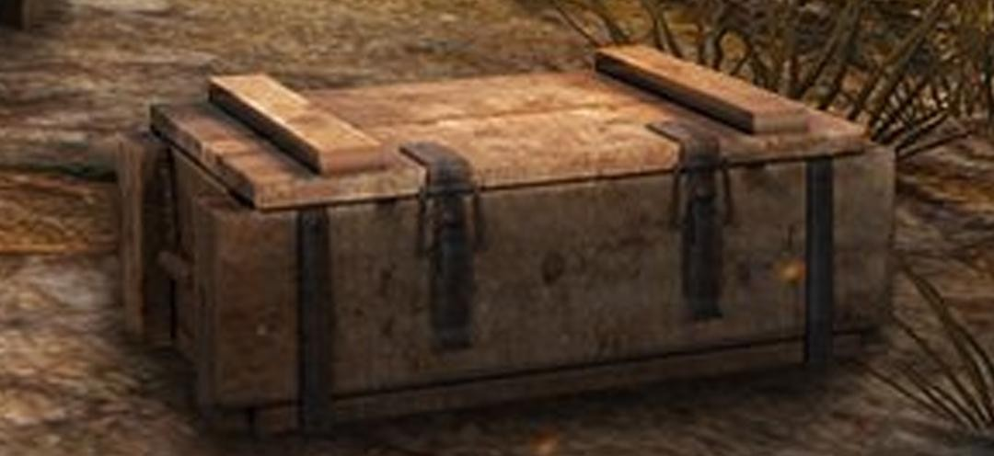
Linear Probing
Let’s define a hash function h(x) = x % 10
delete(32)
Set a special value to mark as deleted
0
1
2
3
4
5
6
7
8
9
null
41
22
DELETED
11
82
null
null
null
null
Why not just set null?

Slide 64
Linear Probing
Let’s define a hash function h(x) = x % 10
search(11)
Now I want to search 11!
0
1
2
3
4
5
6
7
8
9
null
41
22
DELETED
11
82
null
null
null
null
Searching 11...

Slide 65
Linear Probing
Let’s define a hash function h(x) = x % 10
search(11)
h(11) = 1, but that’s not the one we want
0
1
2
3
4
5
6
7
8
9
null
41
22
DELETED
11
82
null
null
null
null
Searching 11...

Slide 66
Linear Probing
Let’s define a hash function h(x) = x % 10
search(11)
Probe linearly again
0
1
2
3
4
5
6
7
8
9
null
41
22
DELETED
11
82
null
null
null
null
Searching 11...
I’LL DO IT AGAIN

Slide 67
Linear Probing
search(11)
NOTE: It sees DELETED here. Means potentially can go on. If it was null, it would have terminated
Let’s define a hash function h(x) = x % 10
0
1
2
3
4
5
6
7
8
9
null
41
22
DELETED
11
82
null
null
null
null
Searching 11...
I’LL DO IT AGAIN

Slide 68
Linear Probing
search(11)
NOTE: It sees DELETED here. Means potentially can go on. If it was null, it would have terminated
Let’s define a hash function h(x) = x % 10
0
1
2
3
4
5
6
7
8
9
null
41
22
DELETED
11
82
null
null
null
null
Searching 11...

Slide 69
Double Hashing

Slide 70
Double Hashing
Use two hash functions f(k), g(k)

Slide 71
Double Hashing
Use two hash functions f(k), g(k)
Define a new hash function: h(k, i) = f(k) + ig(k) mod m
Where i is the number of collisions.

Slide 72
Double Hashing
Use two hash functions f(k), g(k)
Define a new hash function: h(k, i) = f(k) + ig(k) mod m
Where i is the number of collisions.
Helps to have a more “random” probing sequence

Slide 73
Performance
In lecture, it has been shown that once table is near-full, it will perform really really badly

Slide 74
Performance
In lecture, it has been shown that once table is near-full, it will perform really really badly
Solution if the table is near full?

Slide 75

Increase table size!
HASHTABLE

Slide 76
Increase table size!
HASHTABLE

Slide 77
But how much does time it take?
Let’s say:
The old hash table is size m₁
The new hash table is size m₂
The number of elements we have is n
Time complexity?

Slide 78
But how much does time it take?
Let’s say:
The old hash table is size m₁
The new hash table is size m₂
The number of elements we have is n
Time complexity?
O(m₁ + m₂ + n)

Slide 79
What’s the strategy to increase table-size?

Slide 80
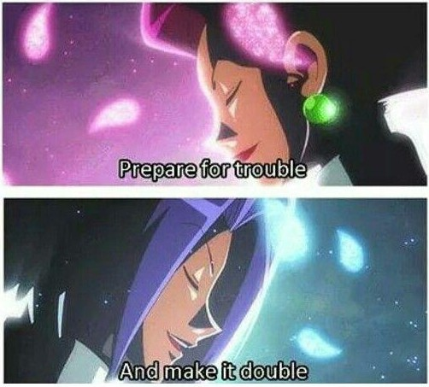
What’s the strategy to increase table-size?
DOUBLE IT!

Slide 81
But how much does time it take?
Let’s say:
The old hash table is size m₁
The new hash table is size m₂
The number of elements we have is n
= n
= 2n
Time complexity?
O(m₁ + m₂ + n)

Slide 82
But how much does time it take?
Let’s say:
The old hash table is size m₁
The new hash table is size m₂
The number of elements we have is n
= n
= 2n
Time complexity?
O(m₁ + m₂ + n) = O(n + 2n + n) = O(n)

Slide 83
Why is this good for insert?

Slide 84
Why is this good for insert?
Idea:
You only need to resize the table occasionally

Slide 85
Why is this good for insert?
Idea:
You only need to resize the table occasionally
A lot and a lot of cheap constant-time inserts

Slide 86
Why is this good for insert?
Idea:
You only need to resize the table occasionally
A lot and a lot of cheap constant-time inserts
And then only when the time comes, you need to do a single expensive operation

Slide 87
No free lunch!
Data Structure | Avg Insert | Avg Search | Avg Max/Min | Avg succ/pred
AVL Tree | O(logn) | O(logn) | O(logn) | O(logn)
Hash Table | O(1) | O(1) | O(n) | O(n)
Where n is the number of items in the data structure.

Slide 88
Problem 1

Slide 89
Q1: Quadratic Probing
a) Insert 42
Done!
[0] 42
[1]
[2]
[3]
[4]
[5]
[6]
h(42) = 42 mod 7 = 0

Slide 90
Q1: Quadratic Probing
a) Insert 24
[0] 42
[1]
[2]
[3] 24
[4]
[5]
[6]
h(24) = 24 mod 7 = 3

Slide 91
Q1: Quadratic Probing
a) ….
[0] 42
[1] 36
[2]
[3] 24
[4] 18
[5]
[6]

Slide 92
Q1: Quadratic Probing
a) Insert 52
[0] 42
[1] 36
[2]
[3] 24 → 52
[4] 18
[5]
[6]
h(52) = 52 mod 7 = 3

Slide 93
Q1: Quadratic Probing
Final Values
[0] 42 → 0 → 7
[1] 36
[2]
[3] 24 → 52 → 45
[4] 18 → 60 → 32
[5] 47
[6] 27

Slide 94
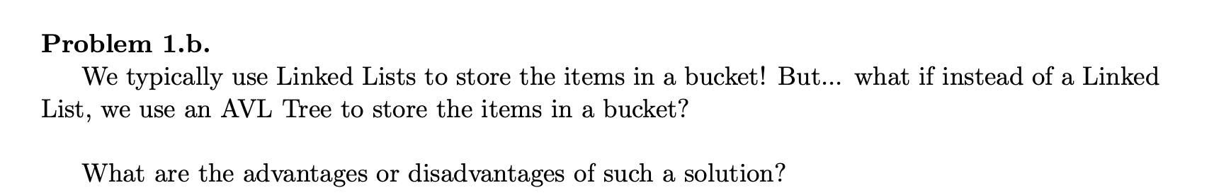

Slide 95
1b) Time Complexity:
Insertion: Linked lists -> O(1) , AVL Trees -> O(logN)
Searching: Linked lists -> O(N), AVL Trees -> O(logN)
Using AVL Tree makes our worst case search more efficient while making our worst case insert less efficient
In reality, if we choose a good hash function that obeys UHA, the expected time would be identical for searching, furthermore AVL tree nodes incur more overhead and are more complex

Slide 96
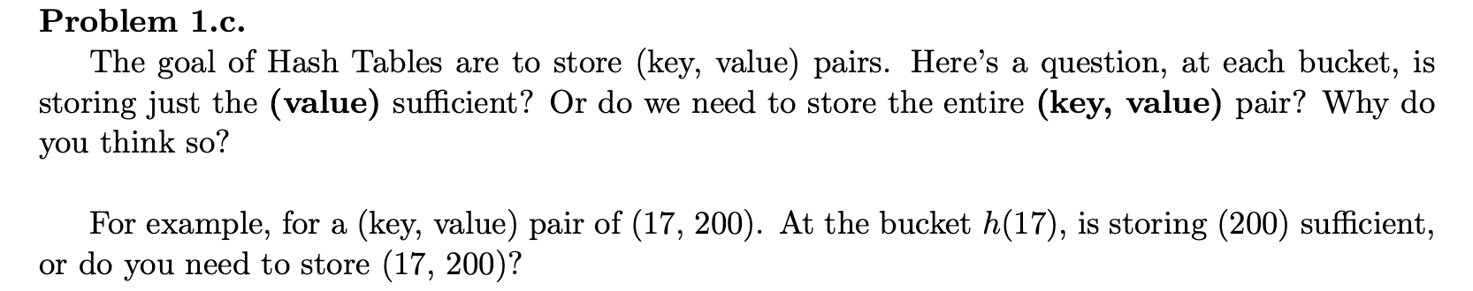

Slide 97
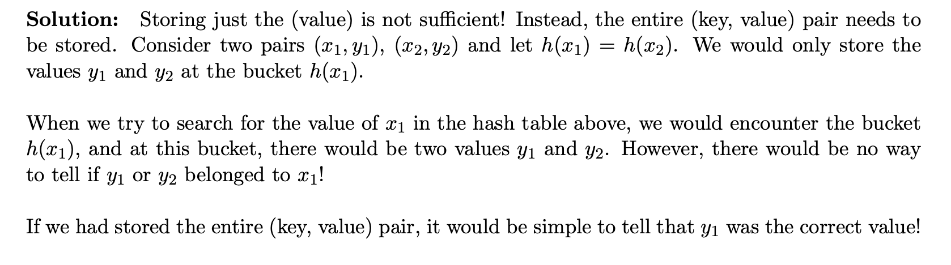

Slide 98
The Missing Element
Let's revisit the same old problem that we've started with since the beginning of the semester, finding missing items in the array. Given 𝑛 items in no particular order, but this time possibly with duplicates, find the first missing number if we were to start counting from 1, or output “all present” if all values 1 to 𝑛 were present in the input.
For example, given [8, 5, 3, 3, 2, 1, 5, 4, 2, 3, 3, 2, 1, 9], the first missing number
here is 6.

Slide 99
The Missing Element
Use a hash table
Enumerate over all the elements in the array and add them to the hash table, ignoring duplicates – 𝑂(𝑛)
Starting from 1, check if the value exists in the hash table – 𝑂(𝑛)
Overall, we get a time complexity of 𝑂(𝑛)

Slide 100
The Missing Element
However, notice that the elements are
Integers
Bounded by 𝑛
We can simply use a direct address table!
A special case of hash tables where the hash function is ℎ(𝑘𝑒𝑦)=𝑘𝑒𝑦
In other words, just use an array of size 𝑛
Same algorithm as previously
Faster than using a hash table
Even though our asymptotic runtime is still 𝑂(𝑛), the constant factor is lower

Slide 101
The Missing Element
Let's revisit the same old problem that we've started with since the beginning of the semester, finding missing items in the array. Given 𝑛 items in no particular order, but this time possibly with duplicates, find the first missing number if we were to start counting from 1, or output “all present” if all values 1 to 𝑛 were present in the input.
For example, given [8, 5, 3, 3, 2, 1, 5, 4, 2, 3, 3, 2, 1, 9], the first missing number
here is 6.
Bonus: Can we do the same thing using 𝑂(1) space? i.e. in-place

Slide 102
The Missing Element
No hash tables used, but is a similar idea to cuckoo hashing
Consider each element in the array once and try to place it in its own index given its value – 𝑂(𝑛)
If there is an element larger than 𝑛, just ignore it as it will not affect the result of our algorithm
Once we have considered all elements in the array, run through the array once more and check if at index 𝑖, the value 𝑖 is stored – 𝑂(𝑛)
Output the first index where this check fails
Overall time complexity of 𝑂(𝑛)

Slide 103
The Missing Element
1 2 3 4 5 6 7 8 9 10 11 12 13 14
8 | 5 | 3 | 3 | 2 | 1 | 5 | 4 | 2 | 3 | 3 | 2 | 1 | 9

Slide 104
The Missing Element
1 2 3 4 5 6 7 8 9 10 11 12 13 14
8 | 5 | 3 | 3 | 2 | 1 | 5 | 4 | 2 | 3 | 3 | 2 | 1 | 9

Slide 105
The Missing Element
1 2 3 4 5 6 7 8 9 10 11 12 13 14
8 | 5 | 3 | 3 | 2 | 1 | 5 | 4 | 2 | 3 | 3 | 2 | 1 | 9
8

Slide 106
The Missing Element
1 2 3 4 5 6 7 8 9 10 11 12 13 14
8 | 5 | 3 | 3 | 2 | 1 | 5 | 8 | 2 | 3 | 3 | 2 | 1 | 9
4

Slide 107
The Missing Element
1 2 3 4 5 6 7 8 9 10 11 12 13 14
8 | 5 | 3 | 3 | 2 | 1 | 5 | 8 | 2 | 3 | 3 | 2 | 1 | 9
4

Slide 108
The Missing Element
1 2 3 4 5 6 7 8 9 10 11 12 13 14
8 | 5 | 3 | 4 | 2 | 1 | 5 | 8 | 2 | 3 | 3 | 2 | 1 | 9
3

Slide 109
The Missing Element
1 2 3 4 5 6 7 8 9 10 11 12 13 14
8 | 5 | 3 | 4 | 2 | 1 | 5 | 8 | 2 | 3 | 3 | 2 | 1 | 9
3

Slide 110
The Missing Element
1 2 3 4 5 6 7 8 9 10 11 12 13 14
8 | 5 | 3 | 4 | 2 | 1 | 5 | 8 | 2 | 3 | 3 | 2 | 1 | 9
3
Index 3 already has the value 3, so we stop cycling

Slide 111
The Missing Element
1 2 3 4 5 6 7 8 9 10 11 12 13 14
8 | 5 | 3 | 4 | 2 | 1 | 5 | 8 | 2 | 3 | 3 | 2 | 1 | 9

Slide 112
The Missing Element
1 2 3 4 5 6 7 8 9 10 11 12 13 14
8 | 5 | 3 | 4 | 2 | 1 | 5 | 8 | 2 | 3 | 3 | 2 | 1 | 9

Slide 113
The Missing Element
1 2 3 4 5 6 7 8 9 10 11 12 13 14
8 | 5 | 3 | 4 | 2 | 1 | 5 | 8 | 2 | 3 | 3 | 2 | 1 | 9
5

Slide 114
The Missing Element
1 2 3 4 5 6 7 8 9 10 11 12 13 14
8 | 5 | 3 | 4 | 5 | 1 | 5 | 8 | 2 | 3 | 3 | 2 | 1 | 9
2

Slide 115
The Missing Element
1 2 3 4 5 6 7 8 9 10 11 12 13 14
8 | 2 | 3 | 4 | 5 | 1 | 5 | 8 | 2 | 3 | 3 | 2 | 1 | 9
2

Slide 116
The Missing Element
1 2 3 4 5 6 7 8 9 10 11 12 13 14
8 | 2 | 3 | 4 | 5 | 1 | 5 | 8 | 2 | 3 | 3 | 2 | 1 | 9
The 2 pointers met, so we have made one cycle
2

Slide 117
The Missing Element
1 2 3 4 5 6 7 8 9 10 11 12 13 14
8 | 2 | 3 | 4 | 5 | 1 | 5 | 8 | 2 | 3 | 3 | 2 | 1 | 9

Slide 118
The Missing Element
1 2 3 4 5 6 7 8 9 10 11 12 13 14
8 | 2 | 3 | 4 | 5 | 1 | 5 | 8 | 2 | 3 | 3 | 2 | 1 | 9

Slide 119
The Missing Element
1 2 3 4 5 6 7 8 9 10 11 12 13 14
8 | 2 | 3 | 4 | 5 | 1 | 5 | 8 | 2 | 3 | 3 | 2 | 1 | 9

Slide 120
The Missing Element
1 2 3 4 5 6 7 8 9 10 11 12 13 14
8 | 2 | 3 | 4 | 5 | 1 | 5 | 8 | 2 | 3 | 3 | 2 | 1 | 9

Slide 121
The Missing Element
1 2 3 4 5 6 7 8 9 10 11 12 13 14
8 | 2 | 3 | 4 | 5 | 1 | 5 | 8 | 2 | 3 | 3 | 2 | 1 | 9

Slide 122
The Missing Element
1 2 3 4 5 6 7 8 9 10 11 12 13 14
8 | 2 | 3 | 4 | 5 | 1 | 5 | 8 | 2 | 3 | 3 | 2 | 1 | 9
1

Slide 123
The Missing Element
1 2 3 4 5 6 7 8 9 10 11 12 13 14
1 | 2 | 3 | 4 | 5 | 1 | 5 | 8 | 2 | 3 | 3 | 2 | 1 | 9
8

Slide 124
The Missing Element
1 2 3 4 5 6 7 8 9 10 11 12 13 14
1 | 2 | 3 | 4 | 5 | 1 | 5 | 8 | 2 | 3 | 3 | 2 | 1 | 9
8

Slide 125
The Missing Element
1 2 3 4 5 6 7 8 9 10 11 12 13 14
1 | 2 | 3 | 4 | 5 | 1 | 5 | 8 | 2 | 3 | 3 | 2 | 1 | 9
8
Index 8 already has the value 8, so we stop cycling

Slide 126
The Missing Element
1 2 3 4 5 6 7 8 9 10 11 12 13 14
1 | 2 | 3 | 4 | 5 | 1 | 5 | 8 | 2 | 3 | 3 | 2 | 1 | 9

Slide 127
The Missing Element
1 2 3 4 5 6 7 8 9 10 11 12 13 14
1 | 2 | 3 | 4 | 5 | 1 | 5 | 8 | 2 | 3 | 3 | 2 | 1 | 9

Slide 128
The Missing Element
1 2 3 4 5 6 7 8 9 10 11 12 13 14
1 | 2 | 3 | 4 | 5 | 1 | 5 | 8 | 2 | 3 | 3 | 2 | 1 | 9
5

Slide 129
The Missing Element
1 2 3 4 5 6 7 8 9 10 11 12 13 14
1 | 2 | 3 | 4 | 5 | 1 | 5 | 8 | 2 | 3 | 3 | 2 | 1 | 9
5
Index 5 already has the value 5, so we stop cycling

Slide 130
The Missing Element
1 2 3 4 5 6 7 8 9 10 11 12 13 14
1 | 2 | 3 | 4 | 5 | 1 | 5 | 8 | 2 | 3 | 3 | 2 | 1 | 9

Slide 131
The Missing Element
1 2 3 4 5 6 7 8 9 10 11 12 13 14
1 | 2 | 3 | 4 | 5 | 1 | 5 | 8 | 2 | 3 | 3 | 2 | 1 | 9

Slide 132
The Missing Element
1 2 3 4 5 6 7 8 9 10 11 12 13 14
1 | 2 | 3 | 4 | 5 | 1 | 5 | 8 | 2 | 3 | 3 | 2 | 1 | 9

Slide 133
The Missing Element
1 2 3 4 5 6 7 8 9 10 11 12 13 14
1 | 2 | 3 | 4 | 5 | 1 | 5 | 8 | 2 | 3 | 3 | 2 | 1 | 9
2

Slide 134
The Missing Element
1 2 3 4 5 6 7 8 9 10 11 12 13 14
1 | 2 | 3 | 4 | 5 | 1 | 5 | 8 | 2 | 3 | 3 | 2 | 1 | 9
2
Index 2 already has the value 2, so we stop cycling

Slide 135
The Missing Element
1 2 3 4 5 6 7 8 9 10 11 12 13 14
1 | 2 | 3 | 4 | 5 | 1 | 5 | 8 | 2 | 3 | 3 | 2 | 1 | 9

Slide 136
The Missing Element
1 2 3 4 5 6 7 8 9 10 11 12 13 14
1 | 2 | 3 | 4 | 5 | 1 | 5 | 8 | 2 | 3 | 3 | 2 | 1 | 9
Let us skip forward…

Slide 137
The Missing Element
1 2 3 4 5 6 7 8 9 10 11 12 13 14
1 | 2 | 3 | 4 | 5 | 1 | 5 | 8 | 2 | 3 | 3 | 2 | 1 | 9

Slide 138
The Missing Element
1 2 3 4 5 6 7 8 9 10 11 12 13 14
1 | 2 | 3 | 4 | 5 | 1 | 5 | 8 | 2 | 3 | 3 | 2 | 1 | 9
9

Slide 139
The Missing Element
1 2 3 4 5 6 7 8 9 10 11 12 13 14
1 | 2 | 3 | 4 | 5 | 1 | 5 | 8 | 9 | 3 | 3 | 2 | 1 | 9
2

Slide 140
The Missing Element
1 2 3 4 5 6 7 8 9 10 11 12 13 14
1 | 2 | 3 | 4 | 5 | 1 | 5 | 8 | 9 | 3 | 3 | 2 | 1 | 9
2

Slide 141
The Missing Element
1 2 3 4 5 6 7 8 9 10 11 12 13 14
1 | 2 | 3 | 4 | 5 | 1 | 5 | 8 | 9 | 3 | 3 | 2 | 1 | 9
2
Index 2 already has the value 2, so we stop cycling

Slide 142
The Missing Element
1 2 3 4 5 6 7 8 9 10 11 12 13 14
1 | 2 | 3 | 4 | 5 | 1 | 5 | 8 | 9 | 3 | 3 | 2 | 1 | 9

Slide 143
The Missing Element
1 2 3 4 5 6 7 8 9 10 11 12 13 14
1 | 2 | 3 | 4 | 5 | 1 | 5 | 8 | 9 | 3 | 3 | 2 | 1 | 9
Now, we just make another pass through the array and see if any elements don’t match their index

Slide 144
The Missing Element
1 2 3 4 5 6 7 8 9 10 11 12 13 14
1 | 2 | 3 | 4 | 5 | 1 | 5 | 8 | 9 | 3 | 3 | 2 | 1 | 9

Slide 145
The Missing Element
1 2 3 4 5 6 7 8 9 10 11 12 13 14
1 | 2 | 3 | 4 | 5 | 1 | 5 | 8 | 9 | 3 | 3 | 2 | 1 | 9

Slide 146
The Missing Element
1 2 3 4 5 6 7 8 9 10 11 12 13 14
1 | 2 | 3 | 4 | 5 | 1 | 5 | 8 | 9 | 3 | 3 | 2 | 1 | 9

Slide 147
The Missing Element
1 2 3 4 5 6 7 8 9 10 11 12 13 14
1 | 2 | 3 | 4 | 5 | 1 | 5 | 8 | 9 | 3 | 3 | 2 | 1 | 9

Slide 148
The Missing Element
1 2 3 4 5 6 7 8 9 10 11 12 13 14
1 | 2 | 3 | 4 | 5 | 1 | 5 | 8 | 9 | 3 | 3 | 2 | 1 | 9

Slide 149
The Missing Element
1 2 3 4 5 6 7 8 9 10 11 12 13 14
1 | 2 | 3 | 4 | 5 | 1 | 5 | 8 | 9 | 3 | 3 | 2 | 1 | 9
Missing number is 6!

Slide 150
Problem 3

Slide 151
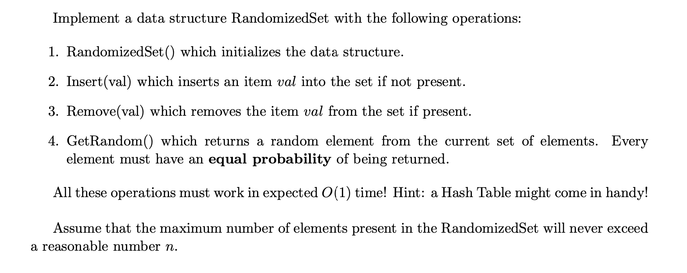

Slide 152
Requirements 1,2,3 can easily be solved using a hash table, how about 4?

Slide 153
New approach, we use an array to store our items, the hash table is used to check if an item is present in the array by mapping the item to its position in the array.
Key | Value
5 | 0
1 | 1
20 | 2
3 | 3
5 | 1 | 20 | 3

Slide 154
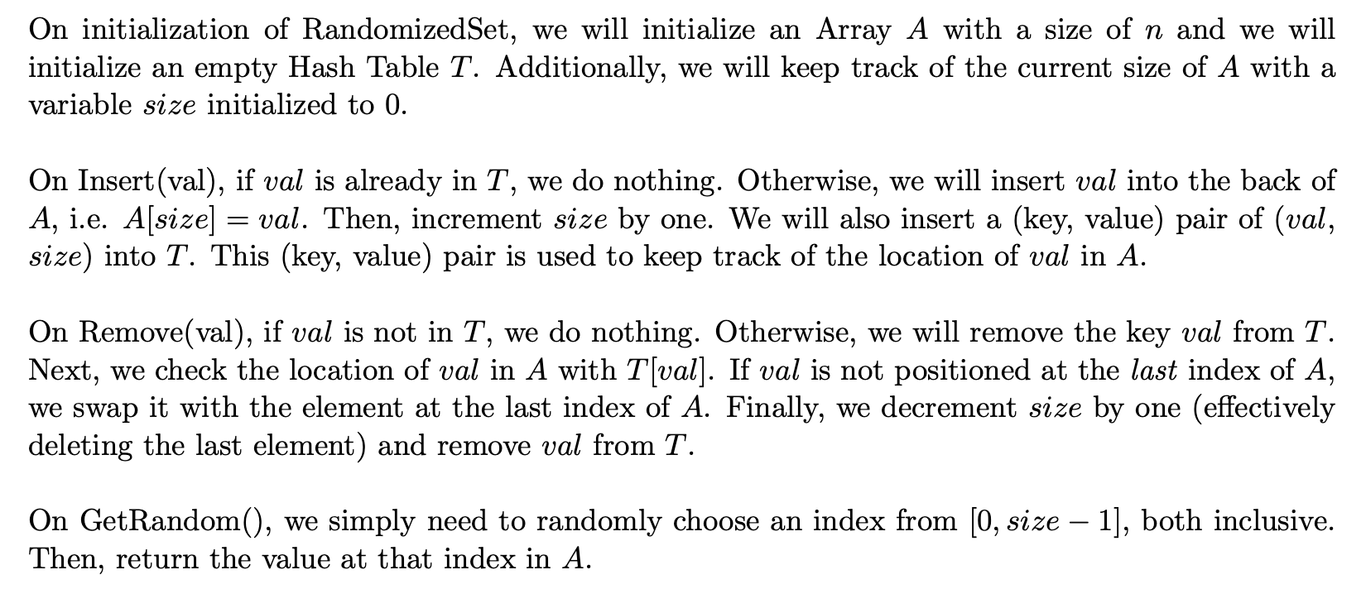
ANS:
Key | Value
5 | 0
1 | 1
20 | 2
3 | 3
5 | 1 | 20 | 3

Slide 155
Problem 4

Slide 156
Data Structure 3.0
Let's try to improve upon the kind of data structures we've been using so far a little. Implement a data structure with the following operations:
Insert in 𝑂(log𝑛 ) time
Delete in 𝑂(log𝑛) time
Lookup in 𝑂(1) time
Find successor and predecessor in 𝑂(1) time

Slide 157
Data Structure 3.0
Use both a balanced binary search tree (BBST) and a hash table
The hash table maps each key to the node it corresponds to
Modify the BBST such that each node stores a pointer to its successor and predecessor nodes

Slide 158
Data Structure 3.0
Insertion – 𝑂(log𝑛)
Insert in the BBST as per normal – 𝑂(log𝑛)
Add the corresponding entry to the hash table – 𝑂(1)
On top of that however, we also run the successor and predecessor algorithm on the inserted node – 𝑂(log𝑛)
Set the predecessor’s successor to the newly inserted node – 𝑂(1)
Set the successor’s predecessor to the newly inserted node – 𝑂(1)
Set the newly inserted node’s successor and predecessor – 𝑂(1)

Slide 159
Key
Value
5
Lookup:
1
20
5
Key
Value
5
Successor:
1
1
20
20
Key | Value
5
1
20
Predecessor:

Slide 160
Key
Value
5
Lookup:
1
20
5
Key
Value
5
Successor:
1
1
20
20
20 has no successor!
Key | Value
5
1
20
Predecessor:

Slide 161
Value
Key
5
Lookup:
1
20
5
Key
Value
5
Successor:
1
1
20
20
20 has no successor!
Key
Value
5
Predecessor:
1
1 has no predecessor!
20

Slide 162
Value
Key
5
Lookup:
1
Insert 3?
20
5
Key
Value
5
Successor:
1
1
20
20
20 has no successor!
Key
Value
5
Predecessor:
1
1 has no predecessor!
20

Slide 163
Value
Key
5
Lookup:
1
Insert 3?
Update hash table! Let’s start from the lookup!
20
3
5
Key
Value
5
Successor:
1
1
20
20
20 has no successor!
3
Key
Value
5
Predecessor:
1
1 has no predecessor!
20

Slide 164
Value
Key
5
Lookup:
1
20
Insert 3?
Update hash table!
3
5
Successor next
Key
Value
5
Successor:
1
1
20
20
20 has no successor!
3
3
Key
Value
5
Update the
inserted node’s
predecessor
(1) to inserted node
Predecessor:
1
as successor
1 has no predecessor!
20

Slide 165
Value
Key
5
Lookup:
1
20
Insert 3?
Update hash table!
3
5
Predecessor next
Key
Value
5
Successor:
1
1
20
20
20 has no successor!
3
3
Key
Value
5
Update the
inserted node’s
successor (5) to inserted node as
Predecessor:
1
1 has no predecessor!
predecessor
20
3

Slide 166
Data Structure 3.0
Deletion – 𝑂(log𝑛)
Delete from the BBST as per normal – 𝑂(log𝑛)
Remove the corresponding entry from the hash table – 𝑂(1)
Set the deleted node’s predecessor’s successor to the deleted node’s successor – 𝑂(1)
Set the deleted node’s successor’s predecessor to the deleted node’s predecessor – 𝑂(1)

Slide 167
Value
Key
5
Lookup:
1
20
Now we delete 3!
3
5
Key
Value
5
Successor:
1
1
20
20
20 has no successor!
3
3
Key
Value
5
Predecessor:
1
1 has no predecessor!
20
3

Slide 168
Value
Key
5
Lookup:
1
20
Now we delete 3! Let’s adjust pointers first before deleting.
3
5
Key
Value
5
Successor:
1
1
20
20
20 has no successor!
3
3
Key
Value
5
Set deleted node’s successor (5)’s
Predecessor:
1
1 has no predecessor!
predecessor, to be the
deleted node’s
20
predecessor
3

Slide 169
Value
Key
5
Lookup:
1
20
Now we delete 3! Let’s adjust pointers first before deleting.
3
5
Key
Value
5
Successor:
1
1
20
20
20 has no successor!
3
3
Key
Value
5
Set deleted node’s predecessor (5)’s
Predecessor:
1
successor, to be the
deleted node’s
1 has no predecessor!
20
successor
3

Slide 170
Value
Key
5
Lookup:
1
20
Now we delete 3! Let’s adjust pointers first before deleting.
3
Just remove
5
Key
Value
5
Successor:
1
1
20
20
20 has no successor!
3
3
Key
Value
5
Predecessor:
1
1 has no predecessor!
20
3

Slide 171
Value
Key
5
Lookup:
1
Now we delete 3!
20
Safe to delete entries!
5
Key
Value
5
Successor:
1
1
20
20
20 has no successor!
Key
Value
5
Predecessor:
1
1 has no predecessor!
20

Slide 172
Data Structure 3.0
Lookup – 𝑂(1)
Use the hash table to find the corresponding node – 𝑂(1)
Find successor and predecessor – 𝑂(1)
First, use the hash table to find the corresponding node – 𝑂(1)
Then, use the successor/predecessor pointer to obtain the successor/predecessor node – 𝑂
(1)

Slide 173
Problem 5

Slide 174
Coupon Chaos
Mr. Nodle has some coupons that he wishes to spend at his favourite cafe on campus, but there are different types of coupons. In particular, there are 𝑡 distinct coupon types, and he can have any number of each type (including 0). He has 𝑛 coupons in total.
He wishes to use one coupon a day, starting from day 1. He wishes to use his coupons in ascending order and will use up all his coupons that are of a lower type first before moving on to the next type. Nodle wishes to build a calendar that will state which coupon he will be using.

Slide 175
Coupon Chaos
The list of coupons will be given in an array. An example of a possible input is: [5, 20, 5, 20, 3, 20, 3, 20]. Here, 𝑡=3, and 𝑛=8. The output here would be [3, 3, 5, 5, 20, 20, 20, 20].
Since the menu at the cafe that he frequents is not very diverse, there aren't many different types of coupons. So we'll say that 𝑡 is much smaller than 𝑛.
Give as efficient an algorithm as you can, to build his calendar for him.

Slide 176
Approach 1: Use an AVL Tree

Slide 177
Approach 1: Use an AVL Tree
The AVL tree uses the type of coupon as keys and stores a counter!
E.g. [5, 1, 20, 3, 20, 3, 20, 1, 1, 1]: t = 4, n = 10
Type
Count

Slide 178
Approach 1: Use an AVL Tree
The AVL tree uses the type of coupon as keys and stores a counter!
E.g. [5, 1, 20, 3, 20, 3, 20, 1, 1, 1]: t = 4, n = 10
Type
Count
5
Count: 1
1
Count: 4
20 Count: 3
3
Count: 2

Slide 179
Approach 1: Use an AVL Tree
The AVL tree uses the type of coupon as keys and stores a counter!
E.g. [5, 1, 20, 3, 20, 3, 20, 1, 1, 1]: t = 4, n = 10
Type
Count
5
Count: 1
Then perform an inorder traversal!
1
Count: 4
20 Count: 3
3
Count: 2

Slide 180
Approach 1: Use an AVL Tree
The AVL tree uses the type of coupon as keys and stores a counter!
E.g. [5, 1, 20, 3, 20, 3, 20, 1, 1, 1]: t = 4, n = 10
Type
Count
5
Count: 1
Then perform an inorder traversal!
1
Count: 4
20 Count: 3
Time Complexity?
3
Count: 2

Slide 181
Approach 1: Use an AVL Tree
The AVL tree uses the type of coupon as keys and stores a counter!
E.g. [5, 1, 20, 3, 20, 3, 20, 1, 1, 1]: t = 4, n = 10
Type
Count
5
Count: 1
Then perform an inorder traversal!
1
Count: 4
20 Count: 3
Time Complexity?
Build this tree O(nlogt) because tree size is t and insert n times
Inorder traversal but print t elements:
O(t)
Total: O(nlogt + t) = O(nlogt)
3
Count: 2

Slide 182
Can we do better?

Slide 183
Approach 2: Hashing!
Idea: Store the counts inside a hash table. Key is the type, Value is the count
E.g. [5, 1, 20, 3, 20, 3, 20, 1, 1, 1]: t = 4, n = 10

Slide 184
Approach 2: Hashing!
Idea: Store the counts inside a hash table. Key is the type, Value is the count
E.g. [5, 1, 20, 3, 20, 3, 20, 1, 1, 1]: t = 4, n = 10
Also keep track of the list of types we have!
Key | Value
5 | 1
1 | 4
20 | 3
3 | 2
5 | 1 | 20 | 3

Slide 185
Approach 2: Hashing!
Idea: Store the counts inside a hash table. Key is the type, Value is the count
E.g. [5, 1, 20, 3, 20, 3, 20, 1, 1, 1]: t = 4, n = 10
Then we sort it!
Key | Value
5 | 1
1 | 4
20 | 3
3 | 2
1 | 3 | 5 | 20

Slide 186
Approach 2: Hashing!
Idea: Store the counts inside a hash table. Key is the type, Value is the count
E.g. [5, 1, 20, 3, 20, 3, 20, 1, 1, 1]: t = 4, n = 10
Then we sort it!
Key | Value
5 | 1
1 | 4
20 | 3
3 | 2
1 | 3 | 5 | 20
And start iterating through!

Slide 187
Approach 2: Hashing!
Idea: Store the counts inside a hash table. Key is the type, Value is the count
E.g. [5, 1, 20, 3, 20, 3, 20, 1, 1, 1]: t = 4, n = 10
Then we sort it!
Key | Value
5 | 1
1 | 4
20 | 3
3 | 2
1 | 3 | 5 | 20
And start iterating through!
Time Complexity:

Slide 188
Approach 2: Hashing!
Idea: Store the counts inside a hash table. Key is the type, Value is the count
E.g. [5, 1, 20, 3, 20, 3, 20, 1, 1, 1]: t = 4, n = 10
Then we sort it!
Key | Value
5 | 1
1 | 4
20 | 3
3 | 2
1 | 3 | 5 | 20
And start iterating through!
Time Complexity:
Expected O(n) time to iterate once and store key-value in Hash Table
O(tlogt) to sort the list of keys
Expected O(n) time to iterate through the types (keys) and output everything
Total: Expected O(n) time [t is much smaller]

